Slide 1
Project Demo
Quantum algorithm on a
subclass of circulant graphs
第二組

Slide 2
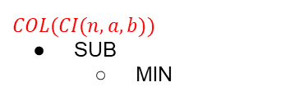
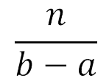
COL(CI(n,a,b))
Subdivide the vertices into consecutive chunks
SUB(Vi) , for i = 1,...,
2-1: Find_MIN(/MAX)_One_Index()
2-2: is_any_one_quantum()
is_any_one_quantum() to search over SUB(Vi)

Slide 3
I/O Introduction
input: graph CI(n,a,b), boolean function f
output:
graph collision: T/F (quantum and classical result)

Slide 4

2. array representing whether each chunk has collision or not
(one calculated by classical approach, one by quantum approach)

Slide 5
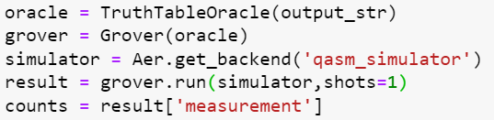
is_any_one_quantum(low_idx,high_idx,f)
index: 0 1 2 3 4 5 6 7
input: (0,7,f = 01011001)
measures 1/3/4/7 with high probability
output: f[measured index]

Slide 6
Find_MIN(/MAX)_One_Index(low_idx,high_idx,f)
1.grover() can find the index of 1
2.keep reducing the range of searching
ex.f = 01011001 output = 4
search f = 01011
index: 0 1 2 3 4 5 6 7 grover()
index: 0 1 2 3 4

Slide 7
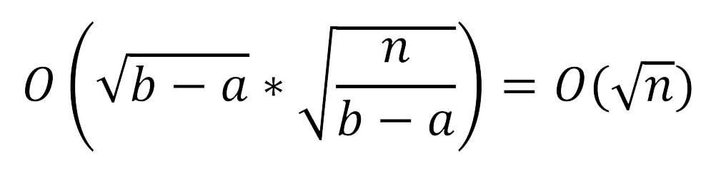

Time Complexity(ideal)
With grover search
there are chunks
 | Classical | Quantum
check_input | O(1) | O(1)
plot | O(n) | O(n)
find_min(/max)_one_idx | O((b-a)* )
is_any_one | O((b-a)* )
total | O(n)

Slide 8
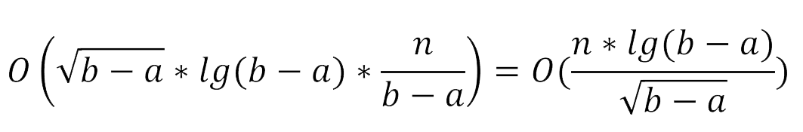
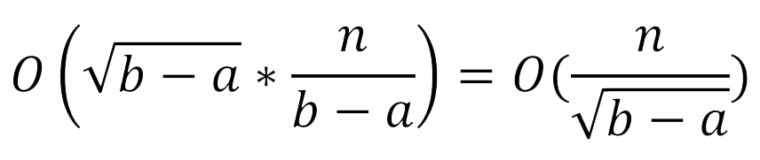
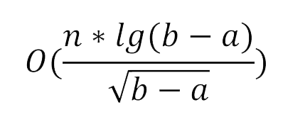
Time Complexity(real)
We see every chunks
 | Classical | Quantum
check_input | O(1) | O(1)
plot | O(n) | O(n)
find_min(/max)_one_idx | O((b-a)* )
is_any_one | O((b-a)* )
total | O(n)

Slide 9
Other reasons for O(n) in quantum
1.need O(n) to change f to string for grover()
2.we use simulator instead of real device

Slide 10
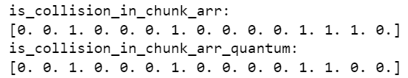
Experiment on Error Analysis
there is some error on the result using quantum simulator
correct
wrong

Slide 11
We will discuss
error probability on any chunk
probability of false alarm and miss detection
repeat to decrease the prob. of false results
time usage when N is large
the collision probability on different N,b-a,p

